Slide 1

APRIL 2023
IoT Bidirectional Visitor Counter using ESPP8266 & MQTT
PROJECT REPORT
APRIL 2023

Slide 2

PROJECT
COMPONENTS USED
DESCRIPTION
COMMUNICATION
TECHNIQUE
FINAL RESULT
Report Outline
PROJECT REPORT
APRIL 2023

Slide 3

PROJECT :
Wireless Bidirectional Visitor Counter using ESP8266 & Blynk
PROJECT REPORT
APRIL 2023

Slide 4

Components Used :
The process for configuring the system and sending the data Wirelessly to various devices requires following components :
1. ESP8266
2. OLED
3. IR Sensor ( 2 )
4. LED’s
5. Jumper Wires
PROJECT REPORT
APRIL 2023

Slide 5
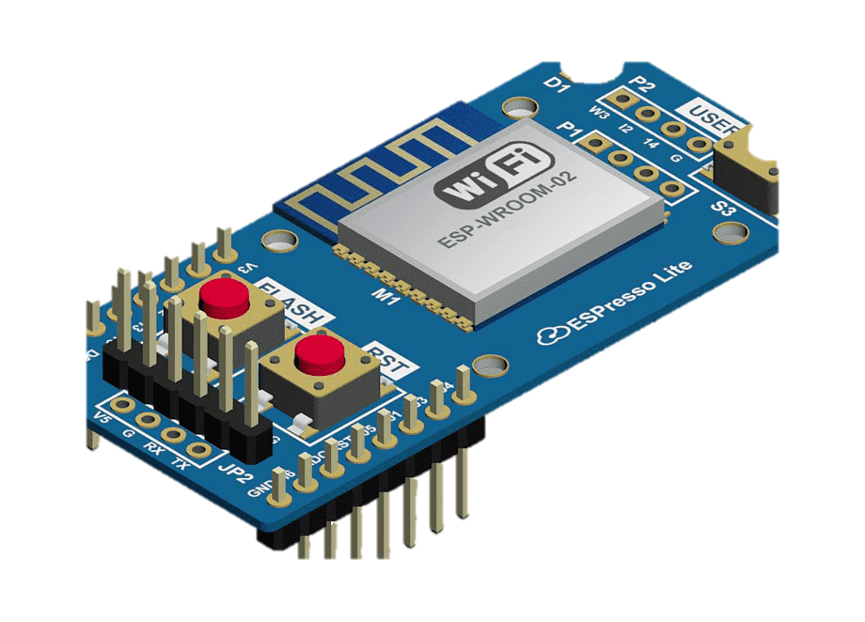
ESP 8266 Module
The ESP8266 is a low-cost Wi-Fi. It can be programmed to perform various tasks, such as connecting to the internet, transmitting data wirelessly. Its small size, low power consumption, and affordability make it an ideal choice.
Clock speed: 80MHz
Flash memory: 512KB to 16MB
RAM: 32KB to 128KB
Interfaces: UART, SPI, I2C, PWM, and GPIO
Operating voltage: 3.3V DC
PROJECT REPORT
APRIL 2023

Slide 6
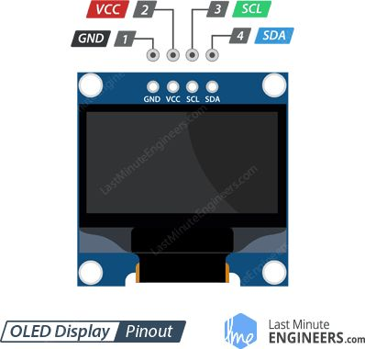
OLED (Organic – LED)
OLED (Organic Light Emitting Diode) is a display technology that uses organic compounds to emit light when an electric current is applied. It produces bright and vivid colors, deep blacks, and consumes less power than traditional LCD screens.
Resolution: Varies depending on the specific display, but can range from 128x64 pixels to 3840x2160 pixels
Color depth: Usually 24-bit (16.7 million colors)
Refresh rate: Typically 60Hz, but can vary depending on the specific display
Response time: Typically less than 0.1ms
PROJECT REPORT
APRIL 2023

Slide 7
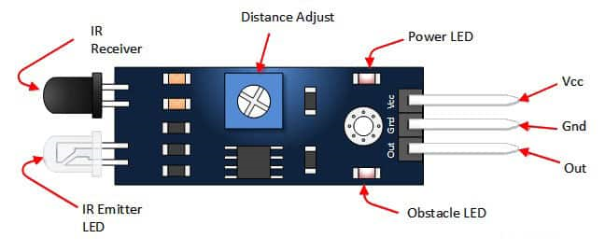
Infrared Led (IR LED)
An IR LED (Infrared Light Emitting Diode) is a type of LED that emits infrared radiation, which is not visible to the human eye.
Wavelength range: Typically between 700nm and 1000nm, depending on the specific LED
Forward voltage: Usually between 1.2V and 1.5V, depending on the specific LED
Beam angle: Varies depending on the specific LED, but typically between 20 degrees and 60 degrees
PROJECT REPORT
APRIL 2023

Slide 8

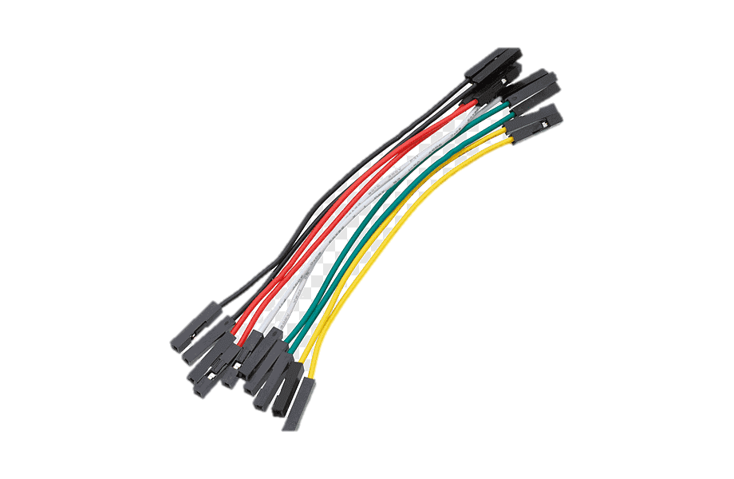
LED’s and Jumper Wires
LED (Light Emitting Diode) is a semiconductor device that emits light when a current is passed through it. LEDs are used in a wide range of applications, including lighting, displays, and indicators.
Jumper wires are electrical wires with connectors at both ends that are used to connect electronic components on a breadboard or prototype board. They are essential for creating temporary circuits and prototyping electronic projects. Jumper wires are available in various lengths, colors, and gauges
PROJECT REPORT
APRIL 2023

Slide 9


Communication Mode:
Wi-Fi (Wireless Fidelity) is a wireless communication technology that allows electronic devices to connect to the internet and communicate with each other without the need for physical cables.
Wi-Fi is based on the IEEE 802.11 family of standards, which defines the specifications for wireless local area networks (WLANs).
It uses radio waves to transmit data between devices, typically operating in the 2.4 GHz or 5 GHz frequency bands
PROJECT REPORT
APRIL 2023

Slide 10
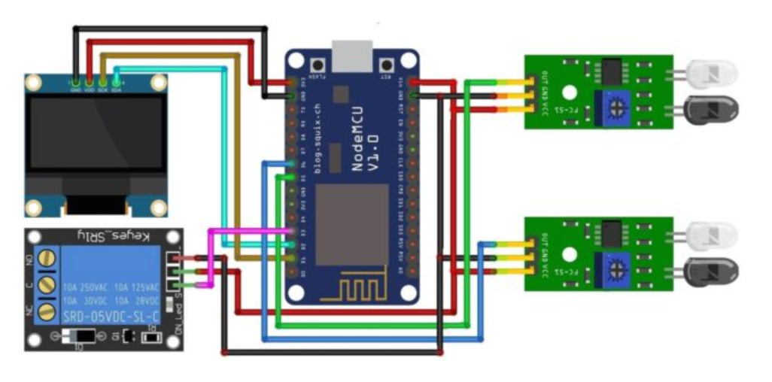
Working :
IR LED WILL LOOK FOR INCOMING PERSONS
DATA WILL BE SEND TO THE NODE MCU BOARD
DATA WILL BE SHOWN ON THE OLED
DATA WILL BE SEND TO THE DEVICES CONNECTED THROUGH THE WIFI MODULE
INTEGRATED
IN THE BOARD
IN
OUT
PROJECT REPORT
APRIL 2023

Slide 11
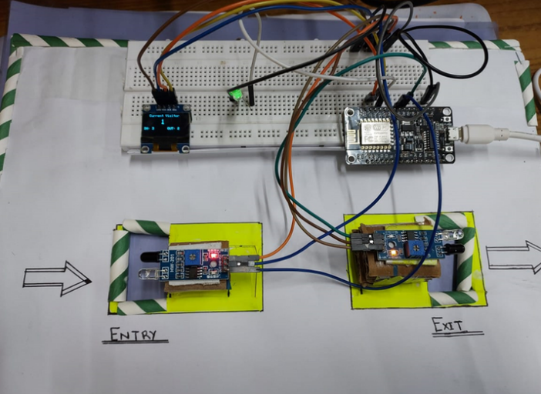

FINAL OUTPUT -
PROJECT REPORT
APRIL 2023

Slide 12

Application :
1.Retail stores: Retail stores can use the system to track the number of people entering and leaving the store. The data can help retailers to understand customer traffic patterns and optimize store layouts, staffing, and inventory management.
2. Hospitals: Hospitals can use the system to monitor the number of visitors entering and leaving the hospital. The data can help hospital administrators to optimize staffing, plan for patient volume
PROJECT REPORT
APRIL 2023

Slide 13

Future Scope :
Integration with Artificial Intelligence (AI): By integrating AI technology, visitor counters could be capable of detecting and identifying different types of visitors. For instance, facial recognition could be used to identify VIPs or frequent visitors, and provide them with personalized services.
Enhanced data analytics: The data generated by visitor counters could be used for more advanced analytics, such as predicting visitor behavior, identifying trends, and generating insights. This could help organizations optimize their operations and improve the visitor experience.
PROJECT REPORT
APRIL 2023

Slide 14

THANKYOU
PROJECT REPORT
APRIL 2023

